Slide 1
Big Data
An Introduction to Big Data

Slide 2
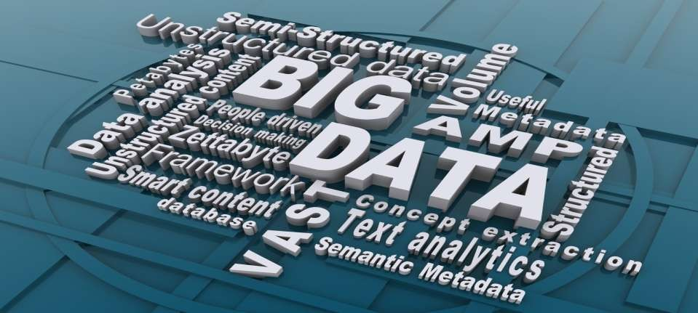
Title
Preethi ananthachari
Asst.professor
Endicott college of international studies
Woosong university
Mob: 01028691177

Slide 3


PhD – India.
Research Area – Mobile Computing, AI, Chaos Theory etc,.
Project Fellow – Major Research Project. UGC Funded.
Msc, M.Phil, MCA.
O/A-Level ICT Teacher in UAE Dubai – 3 years.
My Publications: https://scholar.google.com/citations?user=GNXKkUYAAAAJ&hl=en

Slide 4
What we will cover in this presentation?
What is Big Data?
How is it different from “small data”?
How will it impact our lives?
Is it a good thing?
Big Data sources
Tools, Applications
Risks, Benefits and Future of Big Data

Slide 5
Big Data
Big data is the big thing in the IT world.
The first Organizations to use it were online and startup firms.
Firms like Google, e-Bay, LinkedIn, and Facebook were built around big data from the beginning.
Like many new IT techniques, Big data will bring cost reduction and substantial improvements in the time for performing computing tasks.

Slide 6
What is BIG DATA?
‘Big Data’ is similar to ‘small data’, but bigger in size
but having data bigger it requires different approaches:
– Techniques, tools and architecture
an aim to solve new problems or old problems in a
better way
Big Data generates value from the storage and processing of very large quantities of digital information that cannot be analyzed with traditional computing techniques.

Slide 7
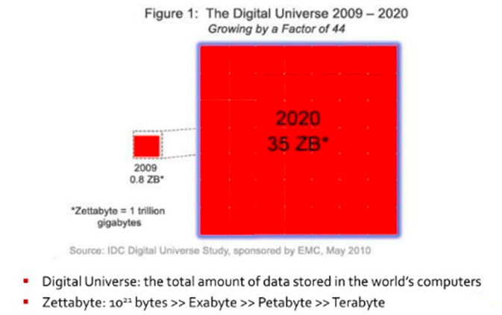
Digital Universe approaches High

Slide 8
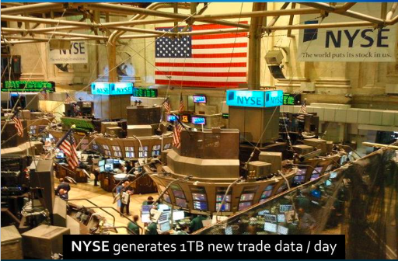
Data Flood

Slide 9

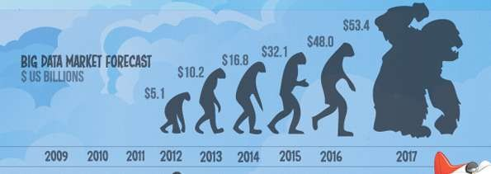
What is BIG DATA
Walmart handles more than 1 million customer transactions every hour.
Facebook handles 40 billion photos from its user base.
Decoding the human genome originally took 10years to process; now it can be achieved in one week.

Slide 10

Types of Data
Quantitative Data
Measurable
Collected through measuring things that have a fixed reality
Close ended
Qualitative Data
Descriptive
Collected through observation, field work, focus groups, interviews, recording or filming conversations
Open ended
Notes:
As a researcher, I thought of data as quantitative or qualitative and that was about it. I focused on what came after the data: journal articles and reports describing the research and what conclusions could be drawn from it. I had heard about “Big Data” from my colleagues.

Slide 11

Big Data
Data that is too large or too complex to be managed using traditional data processing, analysis, and storage techniques.
Notes:
Enter Big Data. A common definition of Big Data is “data that is too large or too complex to be managed using traditional data processing, analysis, and storage techniques.”

Slide 12
The 4 V’s of Big Data
Volume The amount of data | Variety The types of data
Velocity The frequency of data | Veracity The quality of data
Notes:
Big Data is often referred to as having certain attributes, known as the 4 V’s: Volume, Variety, Velocity and Veracity. And now the 5th V is Value.

Slide 13
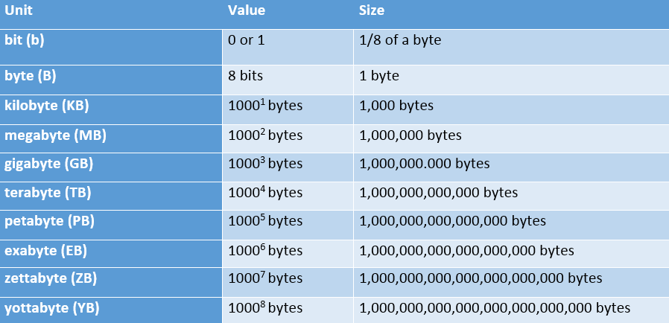

Volume: scale of data
Notes:
We’re all pretty familiar with file sizes in the kilobyte, megabyte, and gigabyte range. When it comes to Big Data, data files can exceed those numbers by several orders of magnitude. Data collections are so larger that they require special storage and analysis options. Enter Hadoop, an open-source software framework for storage and processing of big data sets. One of the creators, Doug Cutting, named it after his 2 year old son’s stuffed elephant.

Slide 14
Volume: scale of data
90% of today’s data has been created in just the last 2 years
Every day we create 2.5 quintillion bytes of data or enough to fill 10 million Blu-ray discs
35 zettabytes (35 trillion gigabytes) of data were created by 2020, an increase of 44 times from 2010, and the equivalent of 5,200 gigabytes of data for every man, woman and child on Earth
Most companies in the US have over 100 terabytes (100,000 gigabytes) of data stored
Notes:
A few examples of the volume of data we are amassing…
The number are truly mind-boggling.

Slide 15














Variety: different forms of data
Notes:
A good way to visualize the variety of Big Data available is to think of social media sites. When we think about varieties of data, it is helpful to also think of it as either structured or unstructured. Structured data is the kind of data we find in a fixed field in a record, file, or spreadsheet. Unstructured data refers to data that doesn’t follow a specific format. Think satellite images, photographs and video, social media data, and medical records.

Slide 16
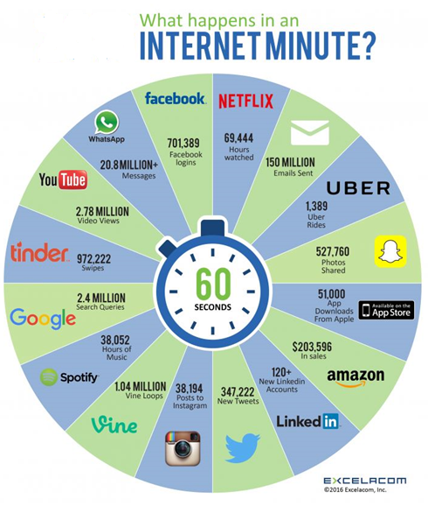
What happens in an Internet minute?
Notes:
Excela, Incorporated’s infographic demonstrates how much data was created in just one Internet minute in 2016…

Slide 17
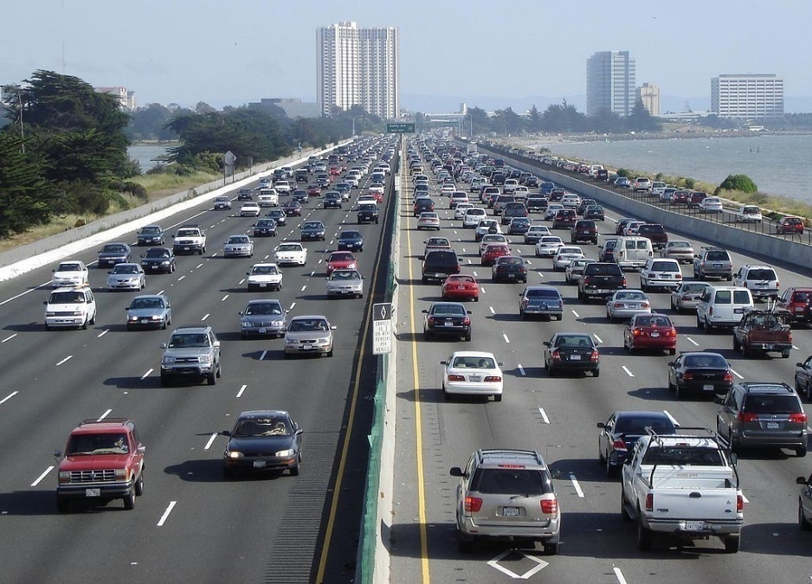

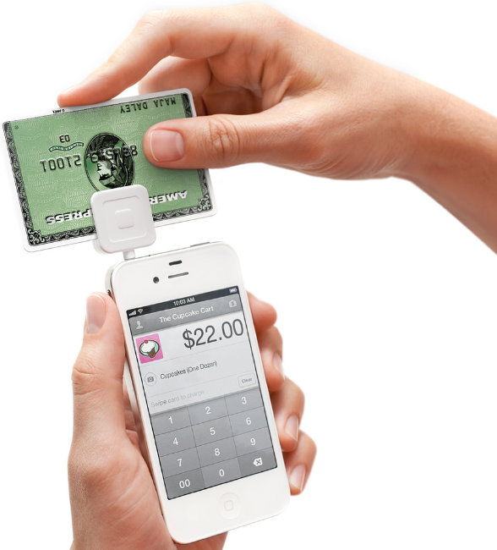



Velocity: analysis of streaming data
Notes:
Velocity refers to the frequency of incoming data that must be processed. Think text messages, Facebook status updates, credit card swipes, the multitude of sensors in modern cars, and the stock exchange.

Slide 18
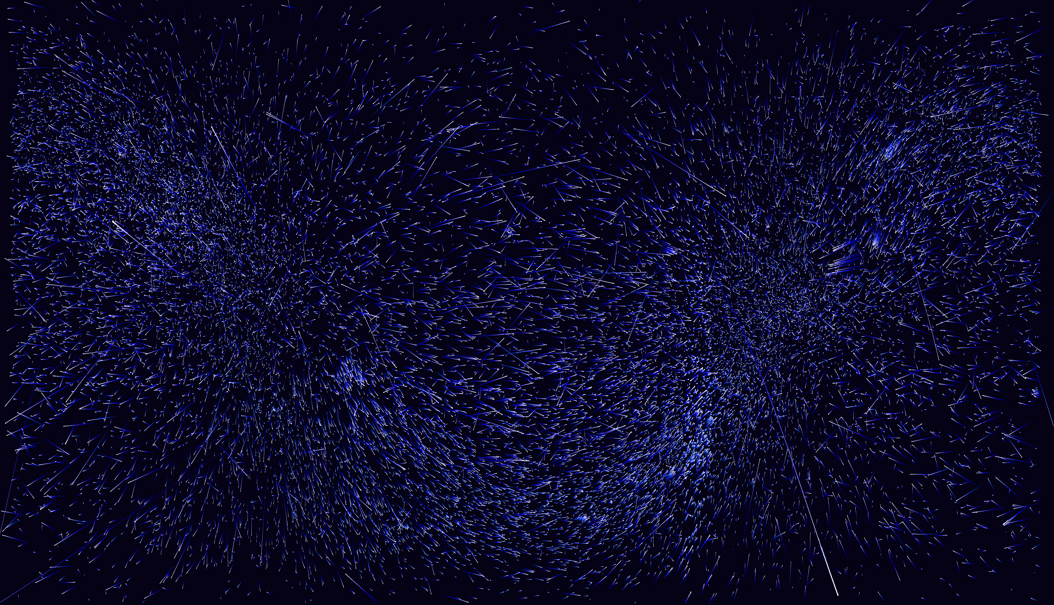
Veracity: trustworthiness of data
Origin
Authenticity
Trustworthiness
Completeness
Integrity
Notes:
Veracity refers to the trustworthiness of data. Librarians are familiar with this concept as it applies to information on the Internet.

Slide 19
The 4 V’s of Big Data
Value
Volume The amount of data | Variety The types of data
Velocity The frequency of data | Veracity The quality of data
Notes:
And finally, Value. Not all data is necessarily valuable data.

Slide 20

Big Data and Research
Notes:
Now let’s take a look at how Big Data is impacting research. You’ll recall from an earlier slide that research has typically involved assembling a sample population and a control group. The data used is just a small subset of a particular group with characteristics of interest. When it comes to Big Data, we can essentially analyze the entire data set, not just a subset.

Slide 21
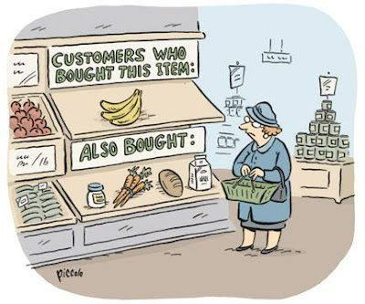
Big Data Mining
Collect Big Data or obtain access to a repository.
Perform data analysis to explore patterns (pattern recognition, predictive analytics).
Identify potential correlations.
4. Good enough!
©Rina Piccolo
Notes:
In order to do so, we need to either have the ability to collect or access huge data sets, perform analyses on them using platforms like Hadoop or supercomputers, and identify interesting correlations among the data. When it comes to Big Data, researchers are more interested in correlation, or the interrelationship between different data. Think Amazon recommendations. Amazon collects data on vast numbers of consumers and using that data, can predict that if you bought bananas, you’ll probably buy milk, as this cartoon illustrates.

Slide 22
Storing Big Data
Analyzing your data characteristics
Selecting data sources for analysis
Eliminating redundant data
Establishing the role of NoSQL
Overview of Big Data stores
Data models: key value, graph, document, column-family
Hadoop Distributed File System
Pig
Hive

Slide 23
Selecting Big Data stores
Choosing the correct data stores based on your data characteristics
Moving code to data
Implementing polyglot data store solutions
Aligning business goals to the appropriate data store

Slide 24
Processing Big Data
Integrating disparate data stores
Mapping data to the programming framework
Connecting and extracting data from storage
Transforming data for processing
Subdividing data in preparation for Hadoop MapReduce
Employing Hadoop MapReduce
Creating the components of Hadoop MapReduce jobs
Distributing data processing across server farms
Executing Hadoop MapReduce jobs
Monitoring the progress of job flows

Slide 25
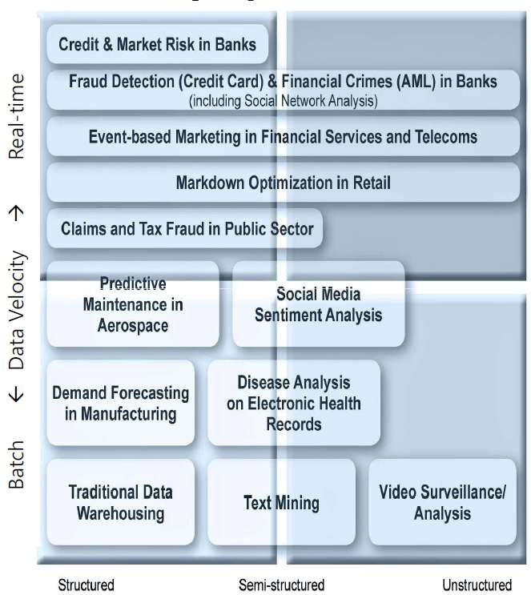
The Structure of Big Data
Structured
Most traditional data sources
Semi-structured
Many sources of big data
Unstructured
Video data, audio data
13

Slide 26
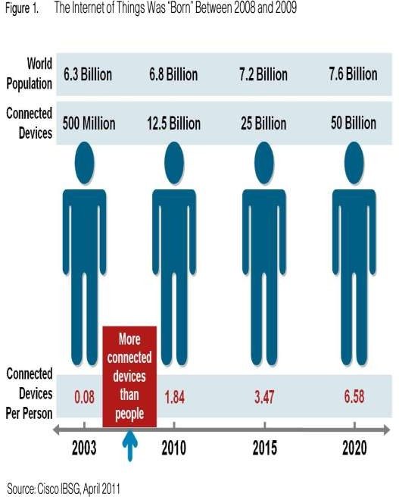
Why Big Data
FB generates 10TB daily
Twitter generates 7TB of data
Daily
IBM claims 90% of today’s stored data was generated in just the last two years.

Slide 27

How Is Big Data Different?
Automatically generated by a machine (e.g. Sensor embedded in an engine)
Typically an entirely new source of data (e.g. Use of the internet)
Not designed to be friendly (e.g. Text streams)
May not have much values
Need to focus on the important part
16

Slide 28
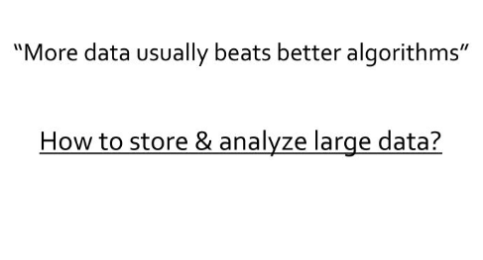
Large Data

Slide 29
Data Storage and Analysis

Slide 30
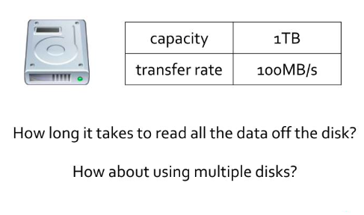
Current Hard Disk Drive

Slide 31
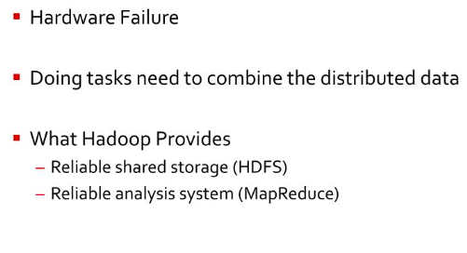
Problems with Multiple disks

Slide 32
Comparison with other systems

Slide 33
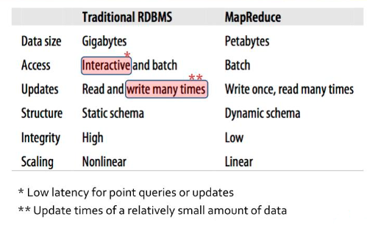
RDBMS

Slide 34
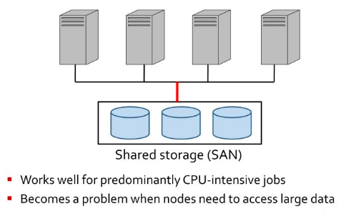
Grid Computing

Slide 35
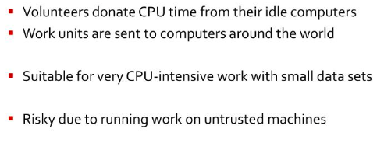
Volunteer Computing

Slide 36
Apache Hadoop File System

Slide 37
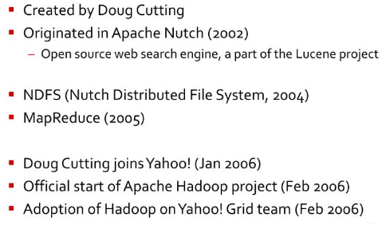
History of Hadoop in Brief

Slide 38
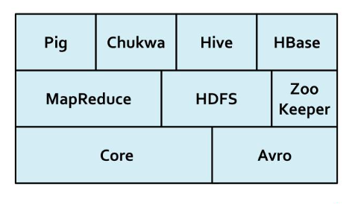
Hadoop Projects

Slide 39
Big Data sources
Users
Large and growing files (Big data files)
Application
Systems
Sensors

Slide 40
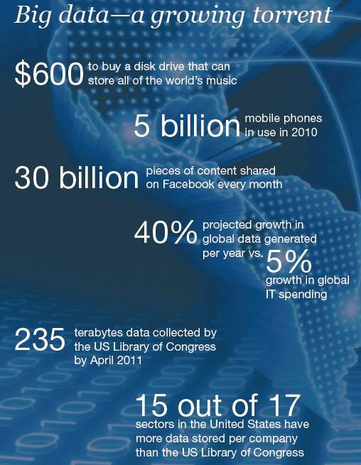
Data generation points Examples
Mobile Devices
Microphones Readers/Scanners Science facilities Programs/ Software Social Media Cameras

Slide 41
Big Data Analytics
Examining large amount of data
Appropriate information
Identification of hidden patterns, unknown correlations
Competitive advantage
Better business decisions: strategic and operational
Effective marketing, customer satisfaction, increased
revenue

Slide 42
Types of tools used in Big-Data
Where processing is hosted?
Distributed Servers / Cloud (e.g. Amazon EC2)
Where data is stored?
Distributed Storage (e.g. Amazon S3)
What is the programming model?
Distributed Processing (e.g. MapReduce)
How data is stored & indexed?
High-performance schema-free databases (e.g. MongoDB)
What operations are performed on data?
Analytic / Semantic Processing

Slide 43





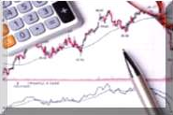


Application Of Big Data analytics
Smarter Healthcare
Multi-channel sales
Homeland Security
Telecom
Traffic Control
Trading
Analytics
Search
Quality
Manufacturing

Slide 44
Leading Technology Vendors
Example Vendors
IBM – Netezza
EMC – Greenplum
Oracle – Exadata
Commonality
MPP architectures
Commodity Hardware
RDBMS based
Full SQL compliance

Slide 45
How Big data impacts on IT
Big data is a troublesome force presenting opportunities with challenges to IT organizations.
Big Data has created 4.4 million IT jobs; 1.9 million is in US itself.
World will require a minimum of 1 lakh data scientists in the next couple of years in addition to data analysts and data managers to support the Big Data space.

Slide 46
Benefits of Big Data
Our newest research finds that organizations are using big data to target customer-centric outcomes, tap into internal data and build a better information ecosystem.
Big Data is already an important part of the $64 billion database and data analytics market
It offers commercial opportunities of a comparable scale to enterprise software in the late 1980s
And the Internet boom of the 1990s, and the social media explosion of today.

Slide 47















Greater availability of data via repositories
The Registry of Research Data Repositories (re3data.org) listed 1,500 research data repositories. Currently 458 are key worded “medicine.”
Notes:
The number of data repositories are exploding and specialize in a huge range of different areas, from images of tumors to genetic data, to infectious disease data. An that’s just in healthcare. Data repositories help to ensure that data is findable, accessible, interoperable, and re-usable.

Slide 48

Contact Information
Dr. Preethi Ananthachari
Email: preethi.ga@wsu.ac.kr 010-28691177
Notes:
And now, because a presentation isn’t complete.
Are there any questions?

Slide 49
Thank You.

